Slide 1
Application Strategy Bingo
Presented by
Cole Cioran

Slide 2
Agenda
1
Blockers
Applications capability and delivery challenges to your IT initiatives
What will we cover?
2
Initiatives
Application initiatives to address your blockers
3
Backlog
Your prioritized application initiative backlog

Slide 3
Why are we here?
Situation
You are tasked to deliver key IT initiatives to achieve your strategic business goals and objectives.
You must deliver and support effective and important applications to build trust and credibility with the business.
Complication
Your IT teams struggle to justify and trace their own tactical initiatives back to business goals.
They cannot confidently rationalize the value of their initiatives in language the business understands.
IT struggles to create valuable applications for CxOs and users.
40%
83%
40% of applications are rated as effective and important by users
83% of users are using applications neither sanctioned or managed by IT
Source: Info-Tech’s Application Portfolio Assessment Diagnostic
Source: CISCO (2016)

Slide 4
How can Info-Tech help?
Focus on Application Value
Build the Right Apps Capabilities
Strengthen Your Application Delivery Process
Prioritize the Right Initiatives
Concentrate your efforts on the delivery of effective and important applications that deliver value for key organizational goals.
Optimize the key applications department capabilities that drive IT satisfaction and build credibility.
Deliver value with sustainable, predictable, and continuously improved throughput using the right practices.
Identify and prioritize the initiatives that will create the right outcomes for your team and stakeholders.

Slide 5
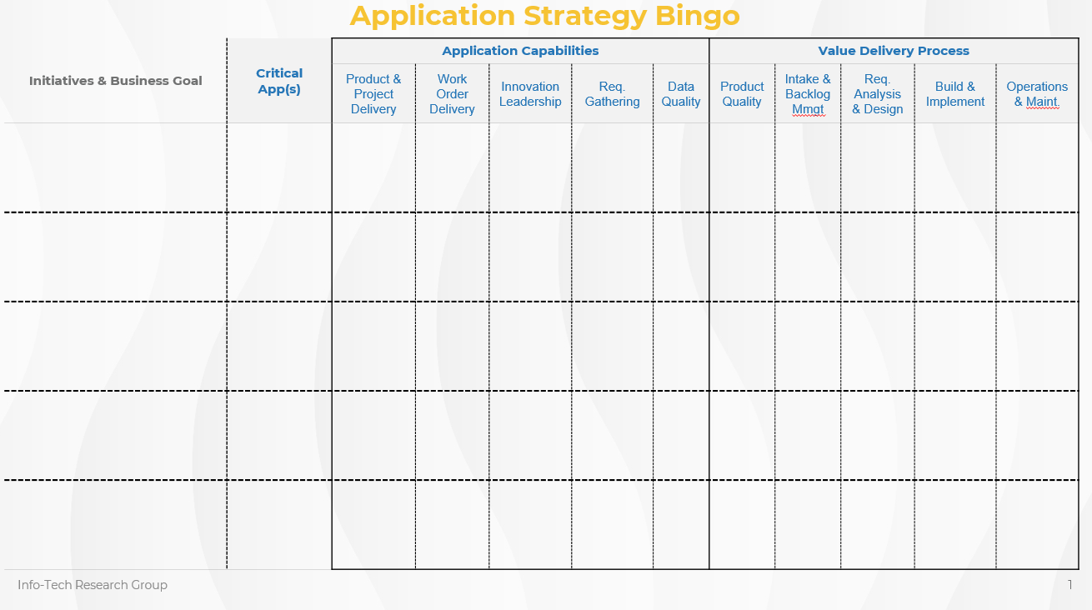
Let’s play Application Strategy Bingo

Slide 6
Activity List your key IT initiatives and goals
Identify
Write down your top-five IT initiatives on your Application Strategy Bingo Card. Indicate the critical applications that will be addressed and impacted by your IT initiatives.
Describe
Pick one initiative. Consider its primary stakeholders, the business goals it is designed to satisfy, and its key outcomes.
Discuss
Share your chosen IT initiative with your group.

Slide 7
Application Strategy Bingo
Key Apps Driver
Initiatives & Business Goal | Critical App(s) | Application Capabilities |  |  |  |  | Value Delivery Process
 |  | Product & Project Delivery | Work Order Delivery | Innovation Leadership | App. Portfolio Mmgt. | Data Quality & Access. | Product Quality | Intake & Backlog Mmgt | Req. Analysis & Design | Build & Implement | Operations & Maint.
Streamline Business Operations | Custom Back Office
Increase Customer Retention | CRM Marketing DB
Increase Market Reach | Website CRM Mobile
Initiative 4
Initiative 5

Slide 8
What needs to change in your Applications department?
Apps Driver
Strengthen Innovation?
Apps Driver
Increase Throughput?
Apps Driver
Optimize Application Selection & Implementation?
Apps Driver
Increase Data Quality & Accessibility?
These are the most-common applications department goals seen by Info-Tech in our applications advisory work.

Slide 9
Activity Identify your key applications department driver
Question
Identify the key goal that your applications department needs to focus on.
Mark
Write the goal in the “Key Apps Goal” box.
Discuss
What’s driving the focus on your selected goal with your group?
n.b. If your key apps driver is something that is not on the list, please list that instead. We will be happy to discuss it further!

Slide 10
Application Strategy Bingo
Key Apps Driver | Increase Throughput
Initiatives & Business Goal | Critical App(s) | Application Capabilities |  |  |  |  | Value Delivery Process
 |  | Product & Project Delivery | Work Order Delivery | Innovation Leadership | App. Portfolio Mmgt. | Data Quality & Access. | Product Quality | Intake & Backlog Mmgt | Req. Analysis & Design | Build & Implement | Operations & Maint.
Streamline Business Operations | Custom Back Office
Increase Customer Retention | CRM Marketing DB
Increase Market Reach | Website CRM Mobile
Initiative 4
Initiative 5

Slide 11
Build IT credibility by focusing on the capabilities that matter
Applications are key to IT success
Reported Importance
Actual Importance
Network Infrastructure
Service Desk
Business Applications
Data Quality
Devices
Client-Facing Technology
Analytical Capability
Work Orders
Innovation Leadership
Projects
IT Policies
Requirements Gathering
1
1
Projects
Work Orders
Innovation Leadership
Requirements Gathering
Business Applications
Service Desk
Network Infrastructure
Data Quality
IT Policies
Analytical Capability
Devices
Client-Facing Technology
2
2
3
3
4
4
5
5
6
6
92%
of organizations with high application suite satisfaction also see high satisfaction with their partnership with IT.
Source: Info-Tech, N=230
7
7
8
8
9
9
10
10
11
11
12
12
Overrated Services
Underrated Services
Info-Tech Business Vision Survey N=283 organizations that completed the CIO Business Vision in 2018. Rank is based on the correlation with Overall IT Satisfaction.

Slide 12
Activity Identify your applications capability blockers
Review
Review the application capability definitions on the back of the Application Strategy Bingo Card. Make any necessary adjustments.
Question
For each application capability and IT initiative, ask yourself: Does my current effectiveness at this capability risk the success of my IT initiatives or negatively impact my business goals?
Mark
Mark an “X” or dab on your bingo card if you answered yes to the above question. These marks will indicate your capability blockers.
Discuss
Discuss the most pressing capability blocker with your group.

Slide 13
Key Apps Driver | Increase Throughput
Application Strategy Bingo
Initiatives & Business Goal | Critical App(s) | Application Capabilities |  |  |  |  | Value Delivery Process
 |  | Product & Project Delivery | Work Order Delivery | Innovation Leadership | App. Portfolio Mmgt. | Data Quality & Access. | Product Quality | Intake & Backlog Mmgt | Req. Analysis & Design | Build & Implement | Operations & Maint.
Streamline Business Operations | Custom Back Office
Increase Customer Retention | CRM Marketing DB
Increase Market Reach | Website CRM Mobile
Initiative 4
Initiative 5

Slide 14
Your software delivery lifecycle (SDLC) is your value delivery engine
An effective SDLC is vital to ensure your products and work orders are delivered with sustainable, predictable, and continuously improved value and throughput.
This lifecycle must accommodate today’s delivery and product realities: changing business priorities and constant product modifications.
Design
Intake
Test
Test
Analyze
Build
Quality
Test
Test
Operate
Retire
Test
Test

Slide 15
Activity Identify your value delivery process blockers
Review
Review the value delivery process definitions on the back of the Application Strategy Bingo Card. Make any necessary adjustments.
Question
For each value delivery process and IT initiative, ask yourself: Does my current effectiveness for this process risk the success of my IT initiatives or negatively impact my business goals?
Mark
Mark an “X” or dab on your bingo card if you answered yes to the above question. These marks will indicate your process blockers.
Discuss
Discuss the most pressing process blocker with your group.

Slide 16
Application Strategy Bingo
Key Apps Driver | Increase Throughput
Initiatives & Business Goal | Critical App(s) | Application Capabilities |  |  |  |  | Value Delivery Process
 |  | Product & Project Delivery | Work Order Delivery | Innovation Leadership | App. Portfolio Mmgt. | Data Quality & Access. | Product Quality | Intake & Backlog Mmgt | Req. Analysis & Design | Build & Implement | Operations & Maint.
Streamline Business Operations | Custom Back Office
Increase Customer Retention | CRM Marketing DB
Increase Market Reach | Website CRM Mobile
Initiative 4
Initiative 5

Slide 17
Activity Prioritize your application initiatives
Review
Review your completed Application Strategy Bingo Card. Look at your marks under the Application Capabilities and Value Delivery Process columns of your bingo card.
Identify
Identify any blockers that span across multiple initiatives. These blockers are your application initiatives. Otherwise, your blockers should be addressed within your IT initiatives.
Prioritize and Discuss
Mark the most important applications that appear to be priorities. Discuss the implications with your group.

Slide 18
Application Strategy Bingo
Key Apps Goal | Increase Throughput
Initiatives & Business Goal | Critical App(s) | Application Capabilities |  |  |  |  | Value Delivery Process
 |  | Product & Project Delivery | Work Order Delivery | Innovation Leadership | App. Portfolio Mmgt. | Data Quality & Access. | Product Quality | Intake & Backlog Mmgt | Req. Analysis & Design | Build & Implement | Operations & Maint.
Streamline Business Operations | Custom Back Office
Increase Customer Retention | CRM Marketing DB
Increase Market Reach | Website CRM Mobile
Initiative 4
Initiative 5
Initiative Focus
App Strat
Focus

Slide 19
Focus on the initiatives that directly support your drivers
Driver: Strengthen Innovation
Driver: Increase Application Delivery Throughput
Driver: Optimize Application Selection & Implementation
Driver: Increase Data Quality & Accessibility
IT Strategy (0.69)
Business Value (0.69)
Measurement (0.66)
IT Policies (0.67) & Stakeholder Relations (0.67)
Product Quality (0.86)
Application Maintenance (0.72)
Application Portfolio Management (0.61)
Application Portfolio Management (0.75)
Requirements Gathering (0.7)
Release Management (0.69)
Data Architecture (0.81)
Business Intelligence & Reporting (0.72)
Quality Management (0.67)
Ranking based on the highest correlation between target capability (i.e. goal) and each capability within the Info-Tech Management and Governance Diagnostic, N=1,287.

Slide 20
Application Strategy Bingo
Key Apps Goal | Increase Throughput
1
Initiatives & Business Goal | Critical App(s) | Application Capabilities |  |  |  |  | Value Delivery Process
 |  | Product & Project Delivery | Work Order Delivery | Innovation Leadership | App. Portfolio Mmgt. | Data Quality & Access. | Product Quality | Intake & Backlog Mmgt | Req. Analysis & Design | Build & Implement | Operations & Maint.
Streamline Business Operations | Custom Back Office
Increase Customer Retention | CRM Marketing DB
Increase Market Reach | Website CRM Mobile
Initiative 4
Initiative 5
Initiative Focus
App Strat
Focus

Slide 21
IT Strategy Sessions
Activities
Business
Goal
IT
Implications
IT
Initiatives
Part 1: Link IT Initiatives to Business Goals
Part 2: Define Strategic Process Improvements
Part 3: Communicate Your IT Strategic Roadmap
Business
Goal
IT
Implications
IT
Initiatives
Infrastructure
Session
Application
Session
Security
Session
Infrastructure
Session
Application
Session
Security
Session
Strategic IT
Initiative
Strategic IT
Initiative
Strategic IT
Initiative
Strategic IT
Initiative
Strategic IT
Initiative
Strategic IT
Initiative
Infrastructure
Implications
Application
Implications
Security
Implications
Infrastructure
Implications
Application
Implications
Security
Process Improvement Projects
Security
Implications
Infrastructure
Process Improvement Projects
Application
Process Improvement Projects
Infrastructure
Projects
Application
Projects
Security
Projects
IT Strategic Roadmap
IT Strategic Roadmap

Slide 22
Key Takeaways
Focus on Application Value
Build the Right Apps Capabilities
Strengthen Your Application Delivery Process
Prioritize the Right Initiatives
Concentrate your efforts on the delivery of effective and important applications that deliver value for key organizational goals.
Optimize the key applications department capabilities that drive IT satisfaction and build credibility.
Deliver value with sustainable, predictable, and continuously improved throughput using the right practices.
Identify and prioritize the initiatives that will create the right outcomes for your team and stakeholders.

Slide 23
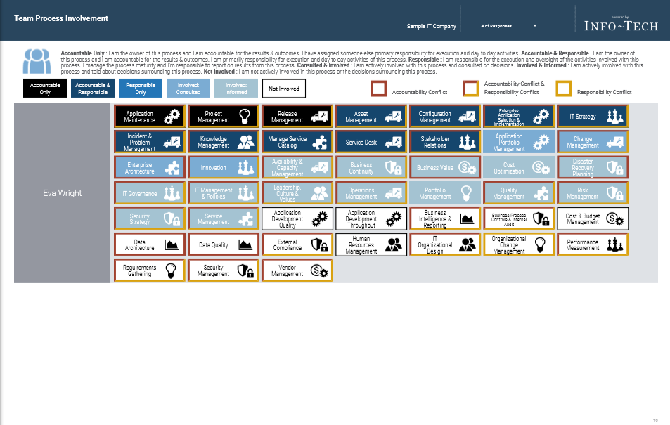
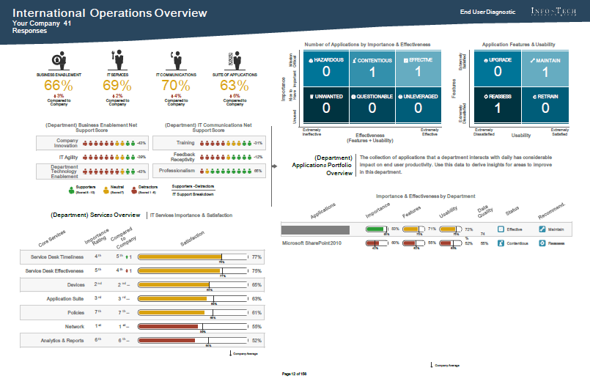
We are here to help!
Info-Tech Diagnostics
IT Management & Governance Diagnostic
Application Portfolio Assessment
Data Quality Scorecard
Leverage Info-Tech’s research and experts to strategize, plan, and mature your applications practice.
Info-Tech Research & Advisory
Application Strategy Review
Integrated Portfolio Dashboard
NEW!
Modernize Your SDLC
Create a Plan for Establishing a Business-Aligned Data Management Practice
23

Slide 24
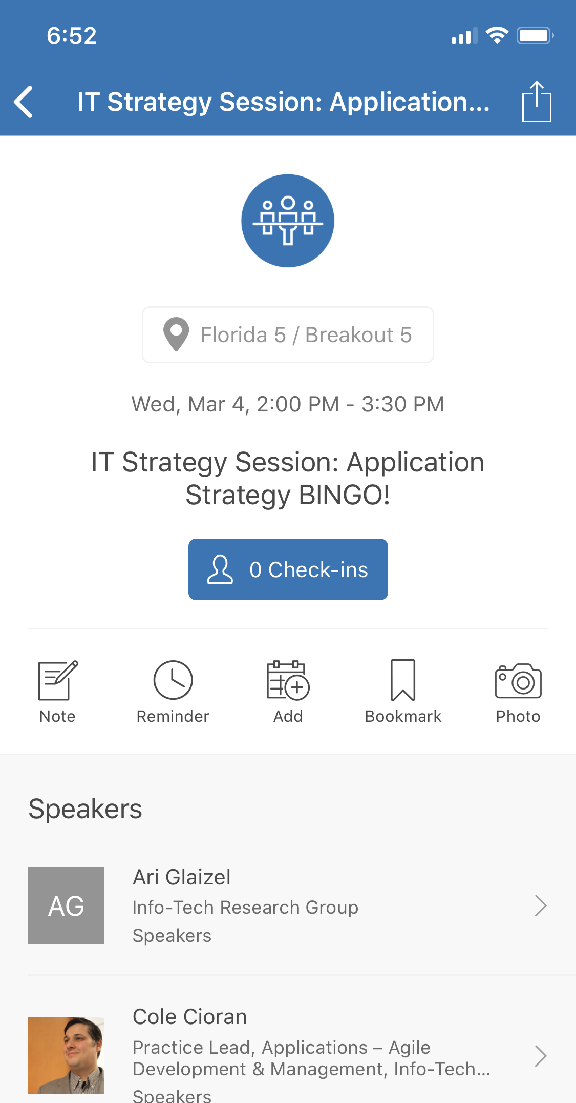
Thank you!
Tell us what you think on the
Info-Tech LIVE mobile app
and for more information please contact:
Cole Cioran
ccioran@infotech.com

Slide 25
Applications Department
App Strategy
APortM
App/Product Quality
Data Architecture
Business Value Measurement
Requirements Management
Vision Backlog, Roadmap
BI & Reporting
Departments Metrics
Release Management
Lifecycle Management
Data Quality
Application Delivery

